Slide 1
The Biosphere and Biomes

Slide 2
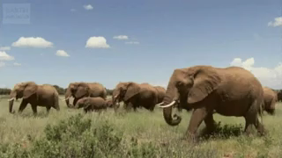
By the end of the lesson, you should be able to:
1. | Describe the different levels of organisation of living things.
2. | Distinguish between the biosphere and a biome.

Slide 3
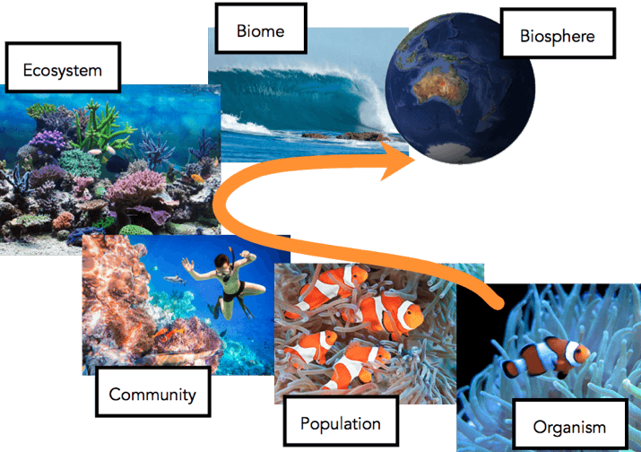
Grouping living things by level of complexity means that ecologists can study them in different ways.
The diagram below illustrates the different levels of organisation of living things.

Slide 4
The arrow moves from the most simple level (organism) of organisation to the most complex level (biosphere).
More factors are incorporated as the levels increase in complexity. For example, the more complex levels take into account other organisms, the environment, and interactions with other species.

Slide 5
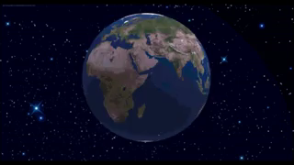
The term 'biosphere' refers to all the places where organisms live.
This ranges from the tallest mountain, to the deepest ocean, and into the sky.

Slide 6
A population is a group of organisms of the same species.
A community is a group containing populations of different species.
An ecosystem contains multiple communities.
A biome contains multiple ecosystems.
The biosphere contains all biomes, and therefore all living things!

Slide 7
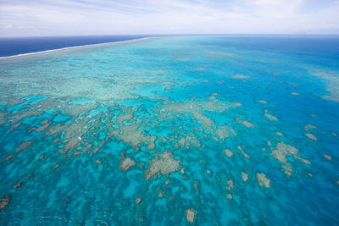
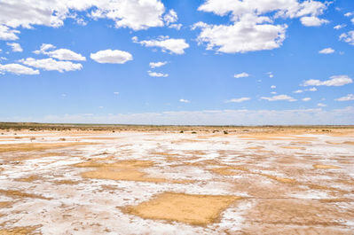
One biome contains all the Earth's ocean environments. Another biome contains all desert environments. There are many different biomes in our wonderful world!

Slide 8
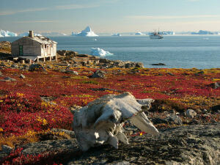
A biome contains many ecosystems.
A biome is characterised by particular organisms and common weather patterns.
For example, the tundra biome contains organisms that are adapted for living in cold climates and wintry weather. One of these organisms is the North American caribou (Rangifer tarandus), which has thick fur and a stocky body to live in cold temperatures.

Slide 9
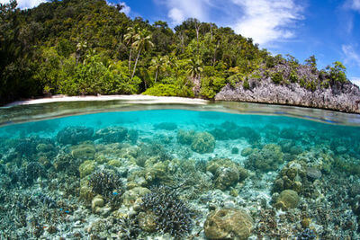
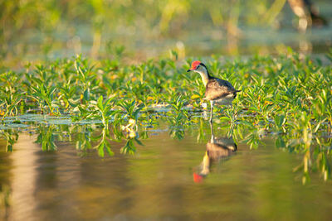
There are five major types of biomes:
1. | Aquatic
2. | Desert
3. | Forest
4. | Grassland
5. | Tundra
The major biomes can then be broken down into more specific regions.

Slide 10
